Slide 1
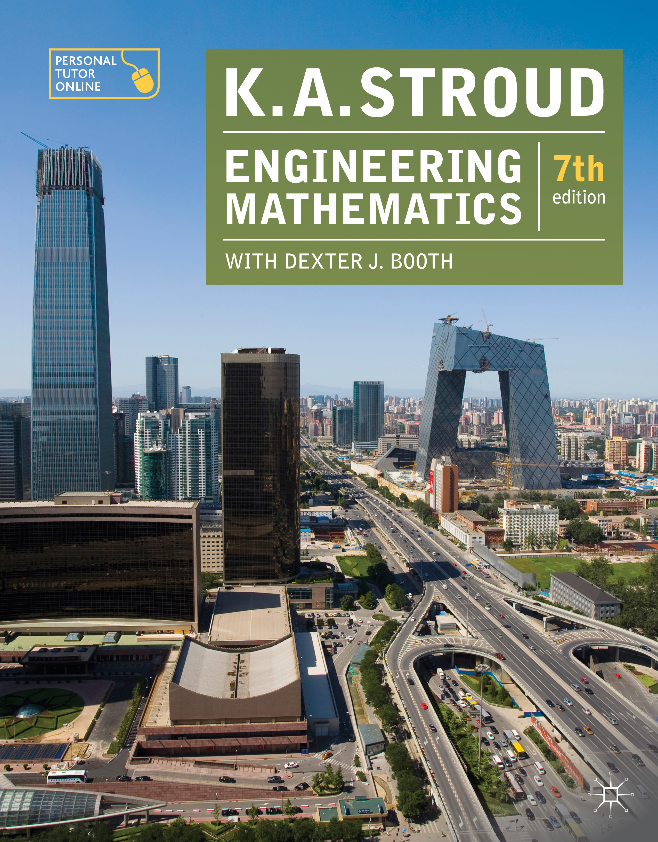
PROGRAMME 1
COMPLEX NUMBERS 1

Slide 2
Introduction
The symbol j
Powers of j
Complex numbers
Graphical representation of a complex number
Polar form of a complex number
Exponential form of a complex number

Slide 3
Introduction
The symbol j
Powers of j
Complex numbers
Graphical representation of a complex number
Polar form of a complex number
Exponential form of a complex number

Slide 4

Introduction
Ideas and symbols
The numerals were devised to enable written calculations and records of quantities and measurements. When a grouping of symbols such as
occurs to which there is no corresponding quantity we ask ourselves why such a grouping occurs and can we make anything of it?
In response we carry on manipulating with it to see if anything worthwhile comes to light.
We call an imaginary number to distinguish it from those numbers to which we can associate quantity which we call real numbers.

Slide 5
Introduction
The symbol j
Powers of j
Complex numbers
Graphical representation of a complex number
Polar form of a complex number
Exponential form of a complex number

Slide 6
Introduction
The symbol j
Powers of j
Complex numbers
Graphical representation of a complex number
Polar form of a complex number
Exponential form of a complex number

Slide 7





The symbol j
Quadratic equations
The solutions to the quadratic equation:
are:
The solutions to the quadratic equation:
are:
We avoid the clumsy notation by defining

Slide 8
Introduction
The symbol j
Powers of j
Complex numbers
Graphical representation of a complex number
Polar form of a complex number
Exponential form of a complex number

Slide 9
Introduction
The symbol j
Powers of j
Complex numbers
Graphical representation of a complex number
Polar form of a complex number
Exponential form of a complex number

Slide 10
Powers of j
Positive integer powers
Negative integer powers

Slide 11
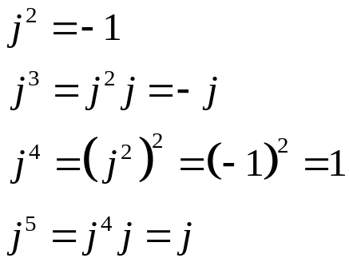
Powers of j
Positive integer powers
Because:
so:

Slide 12
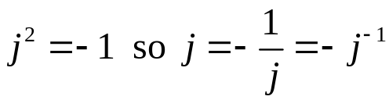
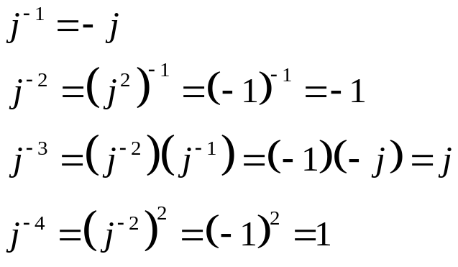
Powers of j
Negative integer powers
Because:
and so:

Slide 13
Introduction
The symbol j
Powers of j
Complex numbers
Graphical representation of a complex number
Polar form of a complex number
Exponential form of a complex number

Slide 14
Introduction
The symbol j
Powers of j
Complex numbers
Graphical representation of a complex number
Polar form of a complex number
Exponential form of a complex number

Slide 15
Complex numbers
Introduction
Addition and subtraction
Multiplication
Complex conjugate
Division
Equal complex numbers

Slide 16
Complex numbers
Introduction
A complex number is a mixture of a real number and an imaginary number. The symbol z is used to denote a complex number.
In the complex number z = 3 + j5:
the number 3 is called the real part of z and denoted by Re(z)
the number 5 is called the imaginary part of z, denoted by Im(z)

Slide 17
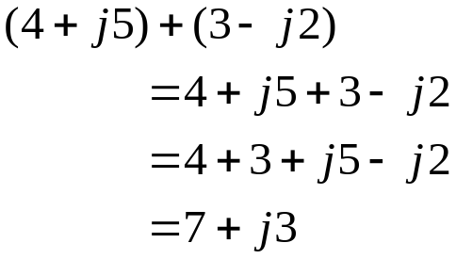
Complex numbers
Addition and subtraction
The real parts and the imaginary parts are added (subtracted) separately:
and so:

Slide 18
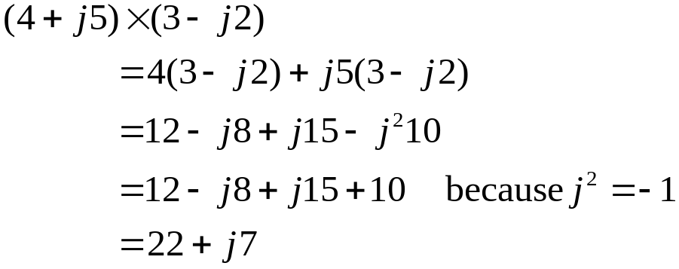
Complex numbers
Multiplication
Complex numbers are multiplied just like any other binomial product:
and so:

Slide 19

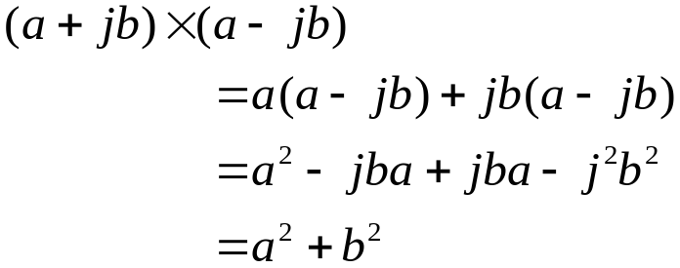
Complex numbers
Complex conjugate
The complex conjugate of a complex number is obtained by switching the sign of the imaginary part. So that:
Are complex conjugates of each other.
The product of a complex number and its complex conjugate is entirely real:

Slide 20
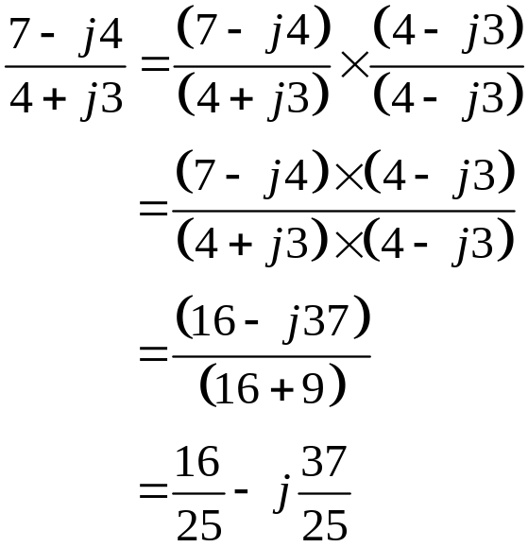
Complex numbers
Division
To divide two complex numbers both numerator and denominator are multiplied by the complex conjugate of the denominator:

Slide 21
Complex numbers
Equal complex numbers
If two complex numbers are equal then their respective real parts are equal and their respective imaginary parts are equal.

Slide 22
Introduction
The symbol j
Powers of j
Complex numbers
Graphical representation of a complex number
Polar form of a complex number
Exponential form of a complex number

Slide 23
Introduction
The symbol j
Powers of j
Complex numbers
Graphical representation of a complex number
Polar form of a complex number
Exponential form of a complex number

Slide 24
Graphical representation of a complex number
Argand diagram
Graphical addition of a complex number

Slide 25
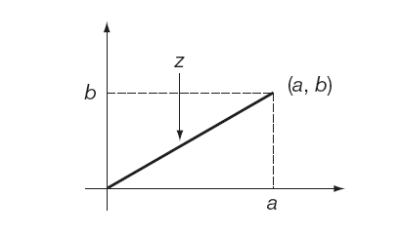
Graphical representation of a complex number
Argand diagram
The complex number z = a + jb can be represented by the line joining the origin to the point (a, b) set against Cartesian axes.
This is called the Argand diagram and the plane of points is called the
complex plane.

Slide 26
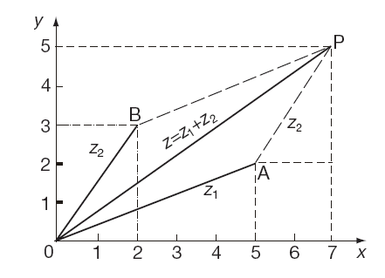

Graphical representation of a complex number
Graphical addition of complex numbers
Complex numbers add (subtract) according to the parallelogram rule:

Slide 27
Introduction
The symbol j
Powers of j
Complex numbers
Graphical representation of a complex number
Polar form of a complex number
Exponential form of a complex number

Slide 28
Introduction
The symbol j
Powers of j
Complex numbers
Graphical representation of a complex number
Polar form of a complex number
Exponential form of a complex number

Slide 29

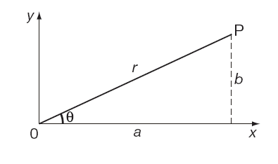
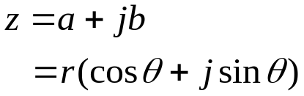


Polar form of a complex number
A complex number can be expressed in polar coordinates r and
where:
and:

Slide 30
Introduction
The symbol j
Powers of j
Complex numbers
Graphical representation of a complex number
Polar form of a complex number
Exponential form of a complex number

Slide 31
Introduction
The symbol j
Powers of j
Complex numbers
Graphical representation of a complex number
Polar form of a complex number
Exponential form of a complex number

Slide 32
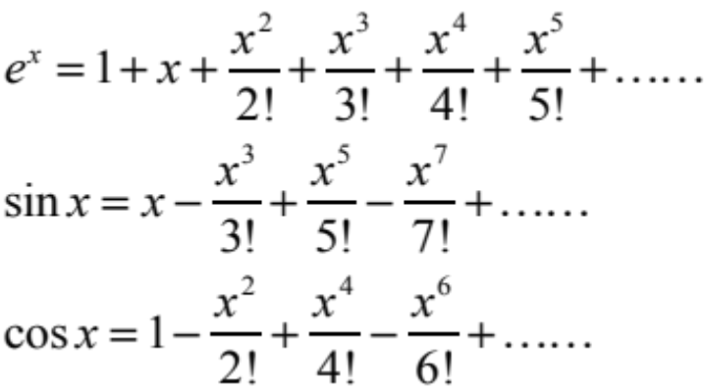
Exponential form of a complex number
Recall the Maclaurin series:

Slide 33
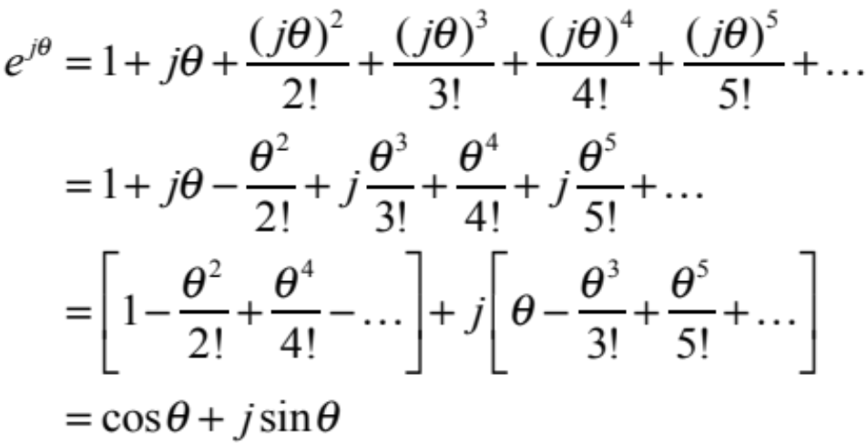
Exponential form of a complex number
So that:

Slide 34

Exponential form of a complex number
Therefore:

Slide 35


Exponential form of a complex number
Logarithm of a complex number
Since:
then:

Slide 36


Learning outcomes
Recognise j as standing for and be able to reduce powers of j to or
Recognize that all complex numbers are in the form (real part) + j(imaginary part)
Add, subtract and multiply complex numbers
Find the complex conjugate of a complex number
Divide complex numbers
State the conditions for the equality of two complex numbers
Draw complex numbers and recognize the paralleogram law of addition
Convert a complex number from Cartesian to polar form and vice versa
Write a complex number on its exponential form
Obtain the logarithm of a complex number

